Slide 1
Module 4: Developing Entity Beans
Notes:
Instructor notes:
This title slide introduces the name of the course.
The targeted duration of the course would let the target audience know about the length of the course.

Slide 2

Module Objectives
In this lesson, you will use EJB Query Language for querying a database and retrieving the desired information.
You will:
Create basic EJB queries.
Create parameterized queries.

Slide 3
Module Coverage
Topic A: Basic EJB Queries
Topic B: Parameterized Queries

Slide 4
Topic A: Basic EJB Queries

Slide 5
Topic A: Basic EJB Queries Agenda
Introduction to EJB Query Language
EJB QL Clauses
QUERY API
Named Query Annotations
Create Basic EJB Queries

Slide 6
Introduction to EJB Query Language
A query is an instruction to select, retrieve, and display information from a database.
A query language provides the commands and keywords that should be used to create the query.
EJB offers a query language for interacting with databases connected to an EJB application.
EJB Query Language (EJB QL) is used to create queries that can be integrated within EJB applications and perform database-related operations.
Notes:
You have experience with a complete EJB application and also input data as a client of the
application. In order to retrieve and view the data that has been stored in an associated database,
you need to perform simple querying on the database, using an EJB application. In this
topic, you will create basic EJB queries for retrieving and displaying persisted data.
Imagine a database that allows you to continually input data but not view what the database
actually contains. That would defeat the intention of securely storing data by prohibiting
required access. Using query languages allows you to access databases securely and efficiently,
without causing any disruption to other records.
EJB Query Language
A query is an instruction to select, retrieve, and display information from a database. A query
language provides the commands and keywords that should be used to create the query.
EJB offers a query language for interacting with databases connected to an EJB application.
EJB Query Language (EJB QL) is used to create queries that can be integrated within EJB
applications and perform database-related operations.

Slide 7
EJB QL Clauses (1 of 2)
EJB QL Clause | Description
SELECT | Specifies the type of values or objects returned by the query.
FROM | Defines the query domain by specifying the identification variables.
WHERE | Specifies the conditional expression that limits the values returned. This clause is optional.
Notes:
EJB QL has a set of three clauses that are used to create simple queries.
SELECT OBJECT(a) FROM User AS a WHERE a.userid = ?1
In the command, the SELECT clause specifies the object to be selected. The FROM
clause specifies the domain from where the object is to be selected and assigns the
selected object to an identification variable a, using the AS keyword. The WHERE
clause specifies the condition restricting the selection to an object with userid 1. In
EJB QL, an input parameter is denoted with a question mark followed by an integer.

Slide 8
EJB QL Clauses (2 of 2)
SELECT OBJECT(a) FROM User AS a WHERE a.userid = ?1
The SELECT clause specifies the object to be selected.
The FROM clause specifies the domain from where the object is to be selected and assigns the selected object to an identification variable a, using the AS keyword.
The WHERE clause specifies the condition restricting the selection to an object with userid 1.
In EJB QL, an input parameter is denoted with a question mark followed by an integer.
Notes:
SELECT OBJECT(a) FROM User AS a WHERE a.userid = ?1
In the command, the SELECT clause specifies the object to be selected. The FROM
clause specifies the domain from where the object is to be selected and assigns the
selected object to an identification variable a, using the AS keyword. The WHERE
clause specifies the condition restricting the selection to an object with userid 1. In
EJB QL, an input parameter is denoted with a question mark followed by an integer.

Slide 9
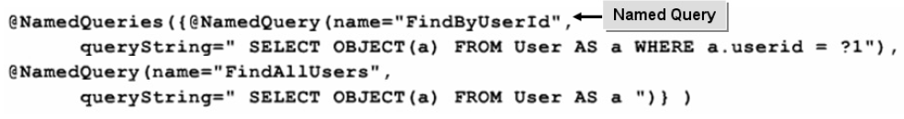
QUERY API
The Query API is offered by the javax.persistence package. The package also offers several annotations for working with named queries.
A named query is a query that is identified and referenced within EJB applications by a name assigned to it.
Notes:
The Query API is offered by the javax.persistence package. The package also offers
several annotations for working with named queries. A named query is a query that is identified
and referenced within EJB applications by a name assigned to it.

Slide 10
Named Query Annotations (1 of 2)
Annotation | Description
@NamedQuery | Used to specify a named query. Syntax: @NamedQuery(name="name of the query",query="command for the query") The name parameter specifies a name for the query and query parameter specifies the EJB QL command to be executed.

Slide 11
Named Query Annotations (2 of 2)
Annotation | Description
@NamedQueries | Used to specify an array of named queries. Syntax: @NamedQueries({@NamedQuery(name="name of the first query", queryString="command for the first query"), @NamedQuery(name="name of the second query", queryString="command for the second query")}) The parameters represent the list of namedqueries used in the class.

Slide 12
Create Basic EJB Queries (1 of 2)
1. In the bean file, import the necessary packages.
2. Add a method to retrieve the records.
3. Save and compile the bean file.
4. In the remote interface, import the necessary packages.
5. Define a method in the remote interface to list all users.
6. Save and compile the remote interface.
7. In the bean class, import the necessary packages.
8. Use the @NamedQueries and @NamedQuery annotations to create named queries.
9. Save and compile the bean class.
10. In the intermediary bean class, add a method to access the method created in the bean file.

Slide 13
Create basic EJB Queries (2 of 2)
11. Set the classpath and compile the intermediary bean class.
12. In the JSP file, add code to create an instance of the bean class by using the jsp:useBean tag and set the variables of the bean class with the elements of the form.
13. Declare a variable and assign the returned results.
14. Type the code to display the details of users.
15. Save and close the file.
16. Create the JAR, WAR, and EAR files.
17. Deploy the application.
18. Test the application.

Slide 14
Activity 4.1: (1 of 26)
Data Files:
UserDetailBean.java
UserDetailRemote.java
User.java
RegBean.java
FindAllUsers.jsp
Before You Begin:
1. From C:\085593Data\EJB Query Language\Activity 1\Starter\mybeans\com\detail, open UserDetailBean.java.
2. Open the command prompt window and navigate to C:\085593Data\EJB Query Language\Activity 1\Starter.
Notes:
Activity Time:
15 minutes
Data Files:
• UserDetailBean.java
• UserDetailRemote.java
• User.java
• RegBean.java
• FindAllUsers.jsp
Before You Begin:
1. From C:\085593Data\EJB Query Language\Activity 1\Starter\mybeans\com\detail, open
UserDetailBean.java.
2. Open the command prompt window and navigate to C:\085593Data\EJB Query Language\
Activity 1\Starter.

Slide 15
Activity 4.1: (2 of 26)
Scenario:
You have developed entity beans for accessing and controlling the database associated with your application. You now need to prepare an entity bean that consists of a method, which will retrieve and view the data that has been stored in an associated database for all required users.
Notes:
Scenario:
You have developed entity beans for accessing and controlling the database associated with
your application. You now need to prepare an entity bean that consists of a method, which will
retrieve and view the data that has been stored in an associated database for all required users.

Slide 16
Activity 4.1: (3 of 26)
What to do | How to do it
In the stateless session bean, implement the findAllUsers() method. | a. After the import javax.persistence.PersistenceContext; statement, import the javax.persistence.Query package. b. Following the createUser() method, add the findAllUsers() method to retrieve the records of all users. (See Code Sample 1). c. Save and close the file.

Slide 17
Activity 4.1: (4 of 26)
Code Sample 1:
public java.util.List<User> findAllUsers()
{
Query query= manager.createNamedQuery("FindAllUsers");
return query.getResultList();
}
Go back

Slide 18
Activity 4.1: (5 of 26)
What to do | How to do it
In the remote interface, define the findAllUsers() method to list all the users. | a. From C:\085593Data\EJB Query Language\Activity 1\Starter\mybeans\com\detail, open UserDetailRemote.java. b. Click after the declaration of the createUser() method and press Enter. c. Declare the findAllUsers() method to list all the users. d. Save and close the file.

Slide 19
Activity 4.1: (6 of 26)
What to do | How to do it
Compile the bean files. | a. Set the class path for the bean file. b. Navigate to C:\085593Data\EJB Query Language\Activity 1\Starter\mybeans. c. Compile the UserDetailBean.java and UserDetailBean.java files.

Slide 20
Activity 4.1: (7 of 26)
What to do | How to do it
In the entity bean class, insert a new named query to find all users. | a. From C:\085593Data\EJB Query Language\Activity 1\Starter\mybeans\com\user, open User.java. b. Following the @Table annotation, add a named query to find all users. (See Code Sample 2) c. Save and close the file. d. Compile the User.java file.

Slide 21
Activity 4.1: (8 of 26)
Code Sample 2:
@Entity
@Table(name="USERDET")
@NamedQueries({
@NamedQuery(name="FindAllUsers",
queryString=" SELECT OBJECT(a) FROM User AS a ")
})
Go back

Slide 22
Activity 4.1: (9 of 26)
What to do | How to do it
In the intermediary bean class, implement the findAllRegUsers() method. | a. From C:\085593Data\EJB Query Language\Activity 1\Starter\myclient\WEB-INF\classes\register, open RegBean.java. b. Following the processRequest() method, add the findAllRegUsers() method to access the findAllUsers() method using an instance of the remote interface. (See Code Sample 3)
Notes:
The :\085593Data\EJB Query Language\Activity 1\Starter\myclient\WEB-INF\classes\register folder can be copy and pasted to any location

Slide 23
Activity 4.1: (10 of 26)
Code Sample 3:
public String processRequest() throws Exception {
String message = "";
System.out.println("Process request called...");
System.out.println(this);
User use = new User();
use.setUserid(userid);
use.setPwd(pwd);
use.setName(name);
use.setEmail(email);
remote.createUser(use);
usercopy=userid;

Slide 24
Activity 4.1: (11 of 26)
Code Sample 3 (cont’d):
…
reset();
loadFromEJB();
message = "You have been successfully registered.";
return message;
}
public List findAllRegUsers()
{
return remote.findAllUsers();
}
Go back

Slide 25
Activity 4.1: (12 of 26)
What to do | How to do it
In the intermediary bean class, implement the findAllRegUsers() method. | c. Save and close the file. d. At the command prompt, navigate to C:\085593Data\EJB Query Language\Activity 1\Starter\myclient\WEB-INF\classes. e. Set the classpath to the mybeans folder. f. Compile the RegBean.java file.
Notes:
Note:
085593Data\EJB Query Language\Activity 1\Starter\myclient\WEB-INF\classes can be copy and pasted to any location

Slide 26
Activity 4.1: (13 of 26)
What to do | How to do it
Configure the client JSP so that it creates an instance of the client bean and calls its methods. | a. From C:\085593Data\EJB Query Language\Activity 1\Starter\myclient, open FindAllUsers.jsp. b. Create an instance of the RegBean class by using the jsp:useBean tag. c. Set the variables of the bean class with the elements of the form in JSP.
Notes:
085593Data\EJB Query Language\Activity 1\Starter\myclient can be copy and pasted to any location

Slide 27
Activity 4.1: (14 of 26)
What to do | How to do it
Configure the client JSP so that it creates an instance of the client bean and calls its methods. | d. Declare a variable called ulist of type List and a variable c of type user, and assign the returned results to ulist. (See Code Sample 4) e. Following the <hr> tag, add the code to display the details of users. (See Code Sample 5) f. Save and close the file.

Slide 28
Activity 4.1: (15 of 26)
Code Sample 4:
<jsp:useBean id="RegBean" scope="session" class="register.RegBean"/>
<jsp:setProperty name="RegBean" property="*" />
<%! java.util.List ulist;
User c=null;
%>
<% ulist = RegBean.findAllRegUsers(); %>
Go back

Slide 29
Activity 4.1: (16 of 26)
Code Sample 5:
<p><p/>
<hr>
<Table border='1' width='222' align='left'>
<tr>
<th width="122">Login ID </th>
<th width="122">Your Name </th>
<th width="122">Password </th>
<th width="122">Email </th>
</tr>
<%
Iterator it = ulist.iterator( );
…

Slide 30
Activity 4.1: (17 of 26)
Code Sample 5 (cont’d):
while (it.hasNext( )) {
c = (User)it.next( );
%>
<tr>
<td> <%=c.getUserid()%> </td>
<td> <%=c.getName()%> </td>
<td> <%=c.getPwd()%> </td>
<td> <%=c.getEmail()%> </td>
</tr>
<%}
%>
</Table>
</body>
Go back

Slide 31
Activity 4.1: (18 of 26)
What to do | How to do it
Create the JAR, WAR, and EAR files. | a. At the command prompt, navigate to C:\085593Data\EJB Query Language\Activity 1\Starter\mybeans. b. Create the mybeans.jar file. c. From C:\085593Data\EJB Query Language\Activity 1\Starter\mybeans, copy mybeans.jar and paste it in C:\085593Data\EJB Query Language\Activity 1\Starter.

Slide 32
Activity 4.1: (19 of 26)
What to do | How to do it
Create the JAR, WAR, and EAR files. | d. At the command prompt, navigate to C:\085593Data\EJB Query Language\Activity 1\Starter\myclient. e. Create the myweb.war file. f. From C:\085593Data\EJB Query Language\Activity 1\Starter\myclient, copy myweb.war and paste it in C:\085593Data\EJB Query Language\Activity 1\Starter.

Slide 33
Activity 4.1: (20 of 26)
What to do | How to do it
Create the JAR, WAR, and EAR files. | g. At the command prompt, navigate to C:\085593Data\EJB Query Language\Activity 1\Starter. h. Create the myregister.ear file.

Slide 34
Activity 4.1: (21 of 26)
What to do | How to do it
Deploy the application. | a. From C:\085593Data\EJB Query Language\Activity 1\Starter, copy myregister.ear and paste it in C:\JBoss\jboss-4.0.3SP1\server\default\deploy. b. At the command prompt, navigate to C:\JBoss\jboss-4.0.3SP1\bin. c. Run the server.

Slide 35
Activity 4.1: (22 of 26)
What to do | How to do it
Run the application. | a. Open Internet Explorer and navigate to http://localhost:8080/UserDetails/Registration.html. b. Enter the values in the text boxes. c. Click Submit. d. In Internet Explorer window, navigate to http://localhost:8080/UserDetails/FindAllUsers.html_x000b_

Slide 36
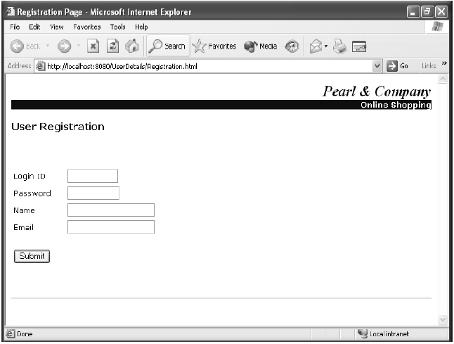
Activity 4.1: (23 of 26)

Slide 37
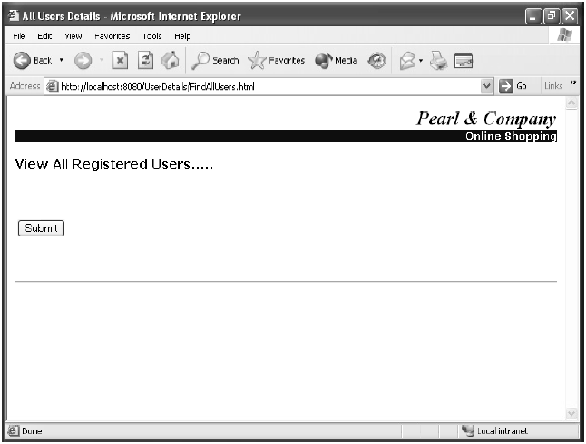
Activity 4.1: (24 of 26)

Slide 38
Activity 4.1: (25 of 26)
What to do | How to do it
Run the application. | e. Click Submit to view the list of registered users. f. Close the Internet Explorer window. g. Stop the server and terminate the batch process. h. Exit the command prompt window.

Slide 39
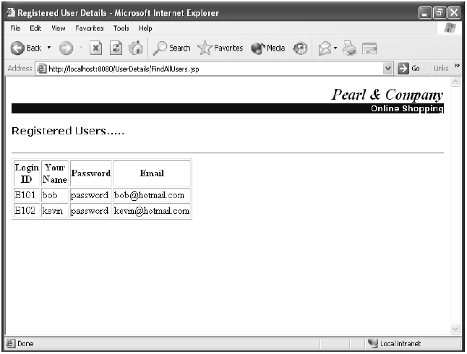
Activity 4.1: (26 of 26)

Slide 40
Topic B: Parameterized Queries

Slide 41
Topic B: Parameterized Queries Agenda
Introduction to Parameterized Queries
Creating Parameterized Queries

Slide 42
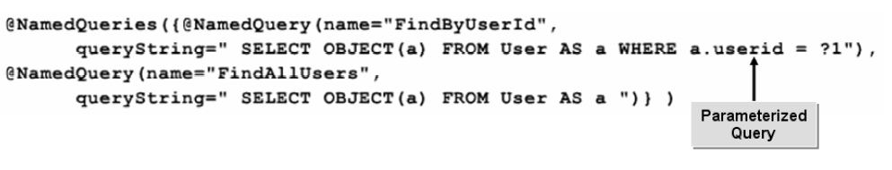
Introduction to Parameterized Queries
Trying to seek specific information in a very large database using basic EJB Query Language will only yield results that require further streamlining.
Parameterized queries are queries that include additional search parameters for streamlining the data that is returned. Using parameters in EJB QL allows you to create applications with refined business logic.
Figure 4.2: A parameterized query streamlines the data returned by specifying additional search conditions
Notes:
Create Parameterized Queries
You have examined how to create basic EJB queries to retrieve required data. In order to
enhance your query and to streamline the data retrieval process, you need to specify parameters
in your queries. In this topic, you will create parameterized queries.
A database can be very large. Trying to seek specific information using basic EJB Query Language
will only yield results that require further streamlining. Using queries that allow you to
specify parameters produces more accurate results. Parameterized queries are an ideal way of
seeking and retrieving information efficiently.
Parameterized Queries
Parameterized queries are queries that include additional search parameters for streamlining
the data that is returned. Using parameters in EJB QL allows you to create applications with
refined business logic.
Figure 4.2: A parameterized query streamlines the data returned by specifying additional
search conditions

Slide 43
Creating Parameterized Queries (1 of 2)
1. In the bean file, create the named query and execute.
2. Save and compile the file.
3. In the bean class, add a named query with parameters.
4. Save and compile the bean class.
5. In the intermediary bean class, create a method of a session bean.
6. If necessary, at the command prompt, set the classpath.
7. Save and compile the intermediary bean class.
8. In the JSP file, add code to create an instance of the bean class by using the jsp:useBean tag and set the variables of the bean class with the elements of the form.

Slide 44
Creating Parameterized Queries (2 of 2)
9. Declare a variable to store the values.
10. Display the details of users.
11. Save and close the file.
12. Create the JAR, WAR, and EAR files.
13. Deploy the application.
14. Test the application.

Slide 45
Activit 4.2: (1 of 24)
Data Files:
UserDetailBean.java
User.java
RegBean.java
FindUserResult.jsp
Before You Begin:
1. From C:\085593Data\EJB Query Language\Activity 2\Starter\mybeans\com\detail, open UserDetailBean.java.
2. Open the command prompt window and navigate to C:\085593Data\EJB Query Language\Activity 2\Starter.
Notes:
Activity Time:
15 minutes
Data Files:
• UserDetailBean.java
• User.java
• RegBean.java
• FindUserResult.jsp
Before You Begin:
1. From C:\085593Data\EJB Query Language\Activity 2\Starter\mybeans\com\detail, open
UserDetailBean.java.
2. Open the command prompt window and navigate to C:\085593Data\EJB Query Language\
Activity 2\Starter.

Slide 46
Activity 4.2: (2 of 24)
Scenario:
You have prepared an entity bean that consists of a method, which retrieves and views the data that has been stored in an associated database for all required users. You now have to prepare an entity bean that consists of a method, which will retrieve all required users, based on user ID.

Slide 47
Activity 4.2: (3 of 24)
What to do | How to do it
In the findByUserId() method, create a named query with parameters. | a. Within the findByUserId() method, add code to create the named query with parameters and execute. (See Code Sample 1) b. Save and close the file. c. Set the class path for the bean file. d. Navigate to C:\085593Data\EJB Query Language\Activity 2\Starter\mybeans. e. Compile the UserDetailBean.java file.

Slide 48
Activity 4.2: (4 of 24)
Code Sample 1:
public User findByUserId(String pKey) {
Query query=manager.createNamedQuery("FindByUserId");
query.setParameter(1, pKey);
return (User)(query.getSingleResult());}
Go back

Slide 49
Activity 4.2: (5 of 24)
What to do | How to do it
Add a named query that includes parameters. | a. From C:\085593Data\EJB Query Language\Activity 2\Starter\mybeans\com\user, open User.java. b. Within the NamedQueries annotation, add the named query with parameters to display the details of the user based on the user id entered. (See Code Sample 2) c. Save and close the file. d. Compile the User.java file.

Slide 50
Activity 4.2: (6 of 24)
Code Sample 2:
@NamedQueries({
@NamedQuery(name="FindByUserId", queryString=" SELECT OBJECT(a) FROM User
AS a WHERE a.userid = ?1"),
@NamedQuery(name="FindAllUsers",
queryString=" SELECT OBJECT(a) FROM User AS a ")
})
Go back

Slide 51
Activity 4.2: (7 of 24)
What to do | How to do it
In the intermediary bean class, implement the findByUserId() method. | a. From C:\085593Data\EJB Query Language\Activity 2\Starter\myclient\WEB-INF\classes\register, open RegBean.java. b. Within the findUser() method, call the findByUserId() method of the session bean by passing the required user id. (See Code Sample 3) c. Save and close the file.

Slide 52
Activity 4.2: (8 of 24)
Code Sample 3:
public User findUser()
{
return remote.findByUserId(userid);
}
Go back

Slide 53
Activity 4.2: (9 of 24)
What to do | How to do it
In the intermediary bean class, implement the findByUserId() method. | d. At the command prompt, navigate to C:\085593Data\EJB Query Language\Activity 2\Starter\myclient. e. Set the classpath to the client file. f. At the command prompt, navigate to C:\085593Data\EJB Query Language\Activity 2\Starter\myclient\WEB-INF\classes. g. Compile the RegBean.java file.

Slide 54
Activity 4.2: (10 of 24)
What to do | How to do it
Configure the client JSP so that it creates an instance of the client bean and calls its methods. | a. From C:\085593Data\EJB Query Language\Activity 2\Starter\myclient, open FindUserResult.jsp. b. Following the <%@ page import="com.user.*,java.util.*"%> statement, create an instance of the RegBean class by using the jsp:useBean tag. c. Set the variables of the bean class with the elements of the form in JSP. (See Code Sample 4)

Slide 55
Activity 4.2: (11 of 24)
Code Sample 4:
<%@ page import="com.user.*,java.util.*"%>
<jsp:useBean id="RegBean" scope="session" class="register.RegBean" />
<jsp:setProperty name="RegBean" property="*" />
Go back

Slide 56
Activity 4.2: (12 of 24)
What to do | How to do it
Configure the client JSP so that it creates an instance of the client bean and calls its methods. | d. Declare a variable called det of type User to store the values returned by the findUser() method. (See Code Sample 5) e. Following the <hr> tag, add code to display the details of users such as login ID, name, password, and email. (See Code Sample 6) f. Save and close the file.

Slide 57
Activity 4.2: (13 of 24)
Code Sample 5:
<jsp:useBean id="RegBean" scope="session" class="register.RegBean" />
<jsp:setProperty name="RegBean" property="*" />
<%! User det=null; %>
<% det = RegBean.findUser(); %>
Go back

Slide 58
Activity 4.2: (14 of 24)
Code Sample 6:
<h1 align="left><b><font face="Verdana" size="3">User Details</font></b>
</h1>
<p></p>
<hr><Table border='1' width='222' align='left'>
<tr>
<td width="122">Login ID: </td>
<td> <%=det.getUserid()%></td>
</tr>
<tr>
<td width="122">Your Name: </td>
<td> <%=det.getName()%></td>
</tr>
<tr>

Slide 59
Activity 4.2: (15 of 24)
Code Sample 6 (cont’d):
<td width="122">Password: </td>
<td> <%=det.getPwd()%></td>
</tr>
<tr>
<td width="122">Email: </td>
<td> <%=det.getEmail()%></td>
</tr>
</Table>
</body>
Go back

Slide 60
Activity 4.2: (16 of 24)
What to do | How to do it
Create the JAR, WAR, and EAR files. | a. At the command prompt, navigate to C:\085593Data\EJB Query Language\Activity 2\Starter\mybeans. b. Create the mybeans.jar file. c. From C:\085593Data\EJB Query Language\Activity 2\Starter\mybeans, copy mybeans.jar and paste it in C:\085593Data\EJB Query Language\Activity 2\Starter.

Slide 61
Activity 4.2: (17 of 24)
What to do | How to do it
Create the JAR, WAR, and EAR files. | d. At the command prompt, navigate to C:\085593Data\EJB Query Language\Activity 2\Starter\myclient. e. Create the myweb.war file. f. From C:\085593Data\EJB Query Language\Activity 2\Starter\myclient, copy myweb.war and paste it in C:\085593Data\EJB Query Language\Activity 2\Starter.

Slide 62
Activity 4.2: (18 of 24)
What to do | How to do it
Create the JAR, WAR, and EAR files. | g. At the command prompt, navigate to C:\085593Data\EJB Query Language\Activity 2\Starter. h. Create the myregister.ear file.

Slide 63
Activity 4.2: (19 of 24)
What to do | How to do it
Deploy the application. | a. From C:\085593Data\EJB Query Language\Activity 2\Starter, copy myregister.ear and paste it in C:\JBoss\jboss-4.0.3SP1\ server\default\deploy. b. At the command prompt, navigate to C:\JBoss\jboss-4.0.3SP1\bin. c. Run the server.

Slide 64
Activity 4.2: (20 of 24)
What to do | How to do it
Run the application. | a. Open Internet Explorer and navigate to http://localhost:8080/UserDetails/Registration.html. b. Enter values in the text boxes. c. Click Submit. d. In the Internet Explorer window, navigate to http://localhost:8080/UserDetails/FindUser.html.

Slide 65
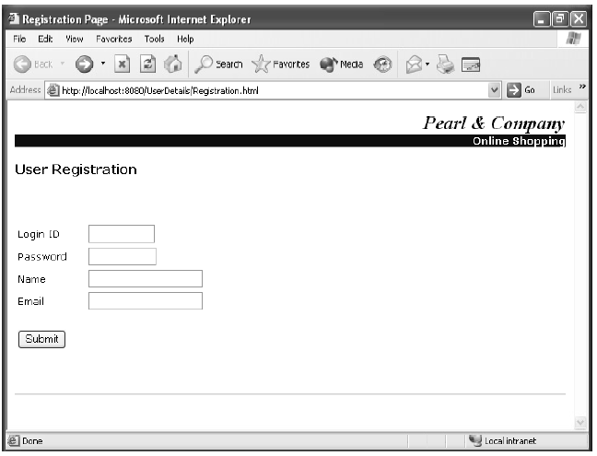
Activity 4.2: (21 of 24)

Slide 66
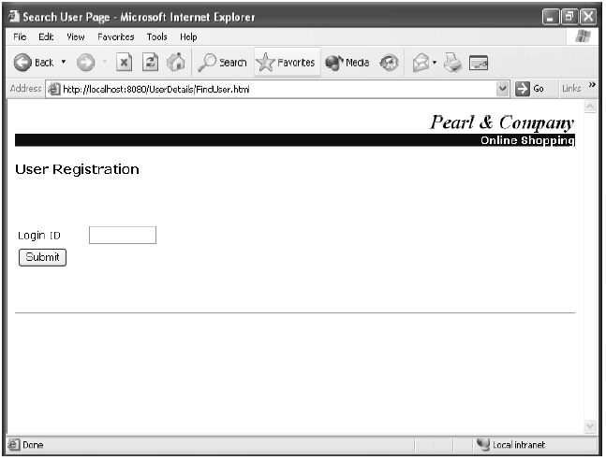
Activity 4.2: (22 of 24)

Slide 67
Activity 4.2: (23 of 24)
What to do | How to do it
Run the application. | e. In the Login ID text box, enter a value and click Submit. f. Observe that the details of the customer having the specified login ID are displayed g. Close the Internet Explorer window. h. Stop the server and terminate the batch process. i. Exit the command prompt window.

Slide 68
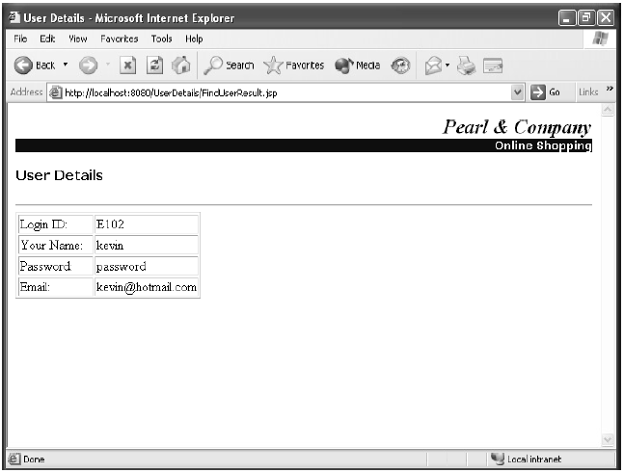
Activity 4.2: (24 of 24)

Slide 69
Module Review
In this lesson, you worked with EJB Query Language for querying a database and retrieved the desired information. You can use EJB QL to retrieve data collectively and selectively.
1. What are the benefits of including abstract schema names in your queries?
2. How can parameterized queries streamline the information you require?
Notes:
In this lesson, you worked with EJB Query Language for querying a database and retrieved the
desired information. You can use EJB QL to retrieve data collectively and selectively.
1. What are the benefits of including abstract schema names in your queries?
Answers will vary.
2. How can parameterized queries streamline the information you require?
Answers will vary.

Slide 70
Module Summary
Having completed this module, you should be able to:
Create Basic EJB Queries.
Create Parameterized Queries.

Slide 71

Congratulations!
Congratulations for completing this module!
Thanks for your participation!

